Slide 1

Year 3
Keynote: e-book
Lesson 1
2025 Term 1.1
Notes:
School ipads
Lesson 2 and 3 might take more than 1 lesson
Slides for Keynote template

Slide 2


Retelling a story with Keynote - WAGOLL
Original
Animation
Notes:
Discuss elements of a story - main characters, problems to solve, resolution, events, emotions etc
How do we create those? With words and pictures
Original :
https://www.youtube.com/watch?v=Dw283LyJKcM

Slide 3
Learning Objectives:
To be able to format slides on Keynote
To be able to trace an image
To be able to animate my slides to create an ebook
To be able to publish my work

Slide 4

The Colour Monster
Notes:
What do they remember about this story from Year 2?

Slide 5
Getting Started
Get your school iPad
Find Keynote
Open a “The Colour Monster - BLANK”
Rename ‘Ms Rhian - 3N’
Open it up

Slide 6
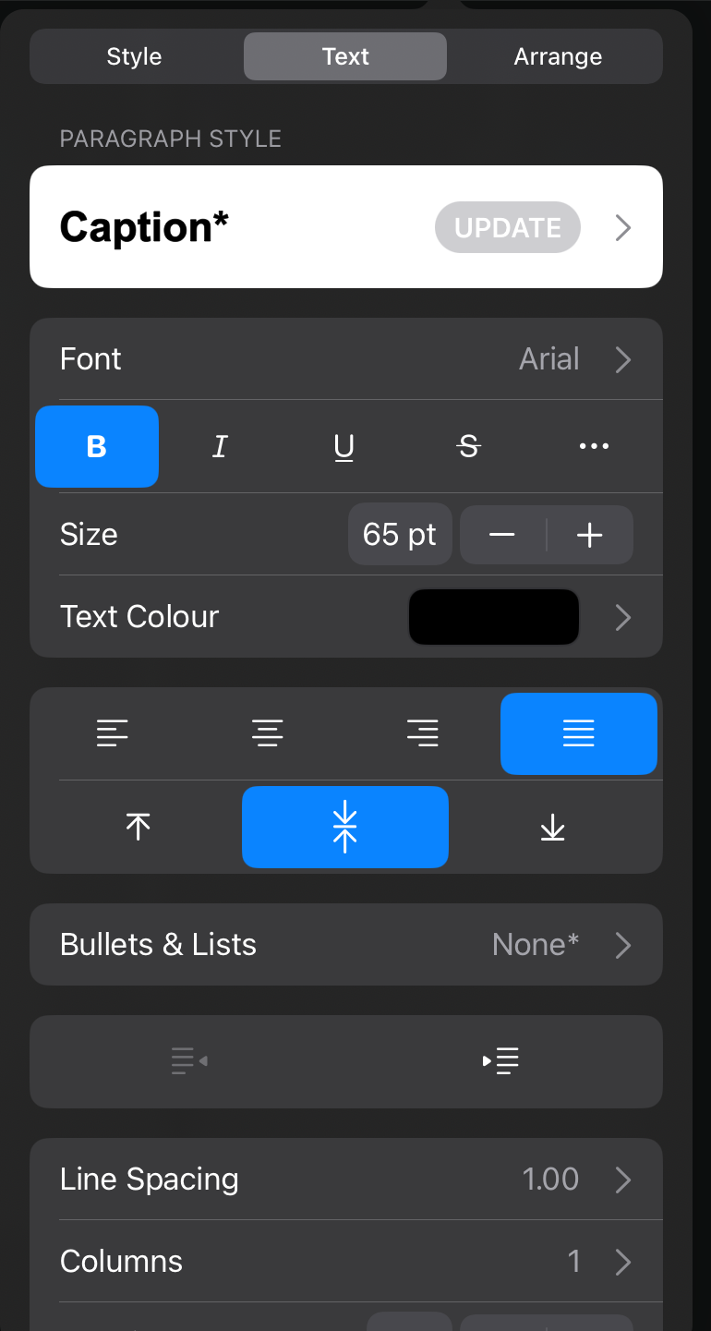
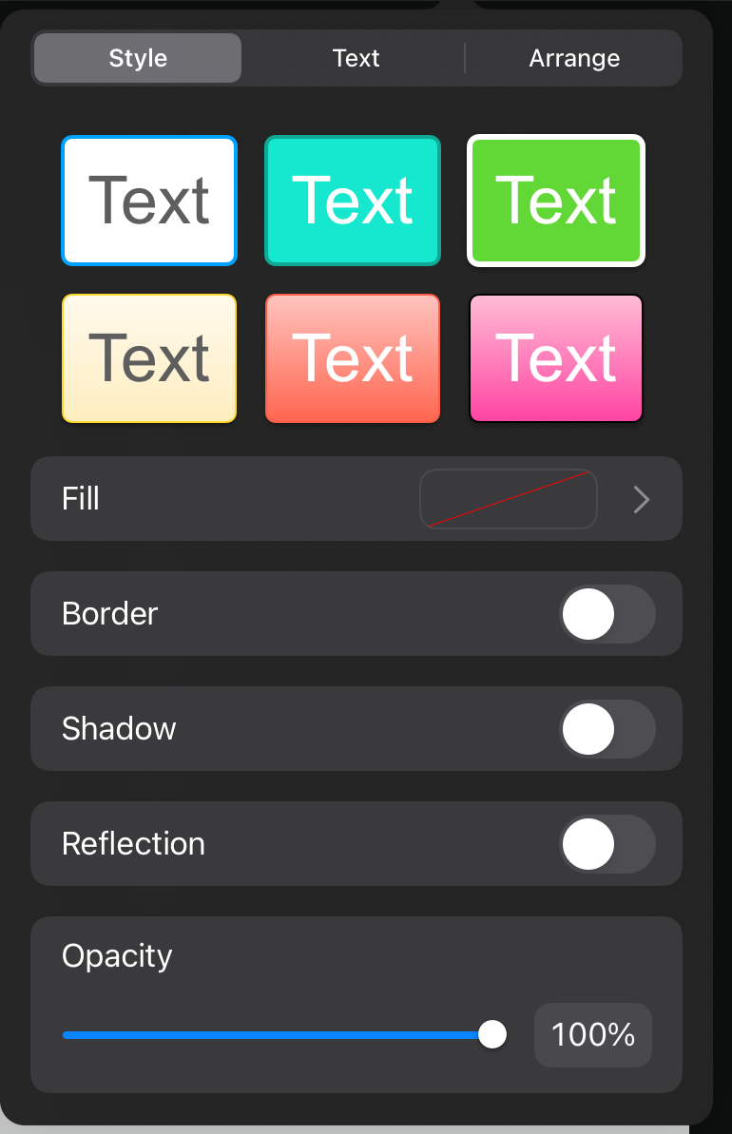
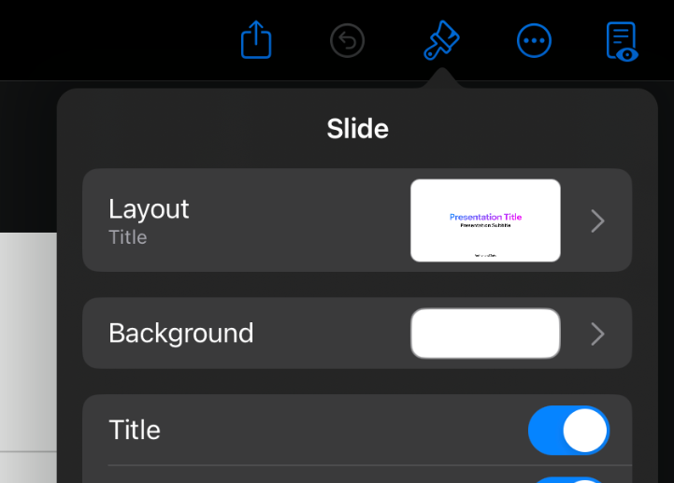
To be able to format slides on Keynote:
Change the background
Size of text
Font type (same for every slide)
Colour of font
Position of font
Position of images
Notes:
Go over what ‘format’ means
Model all of the above - they spend the lesson formatting

Slide 7
Year 3
Keynote: e-book
Lesson 2
2025 Term 1.1

Slide 8
What does it mean to ‘format’ a slide?

Slide 9
Learning Objectives:
To be able to format slides on Keynote
To be able to trace an image
To be able to animate my slides to create an ebook
To be able to publish my work

Slide 10
What you should have so far:
Your own copy of the slides on Keynote
Make sure your copy has YOUR NAME
Check the story is in the correct order
All slides formatted clearly (same font)

Slide 11

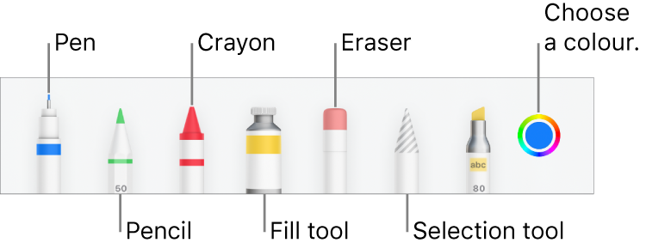
How can we trace an image?
Get YOUR iPad
Open your story
You need an Apple pen
Scribble mode off
Choose 3 or 4 images you want to trace and animate
Vocab Opacity Transparent
Notes:
Model on your ipad

Slide 12
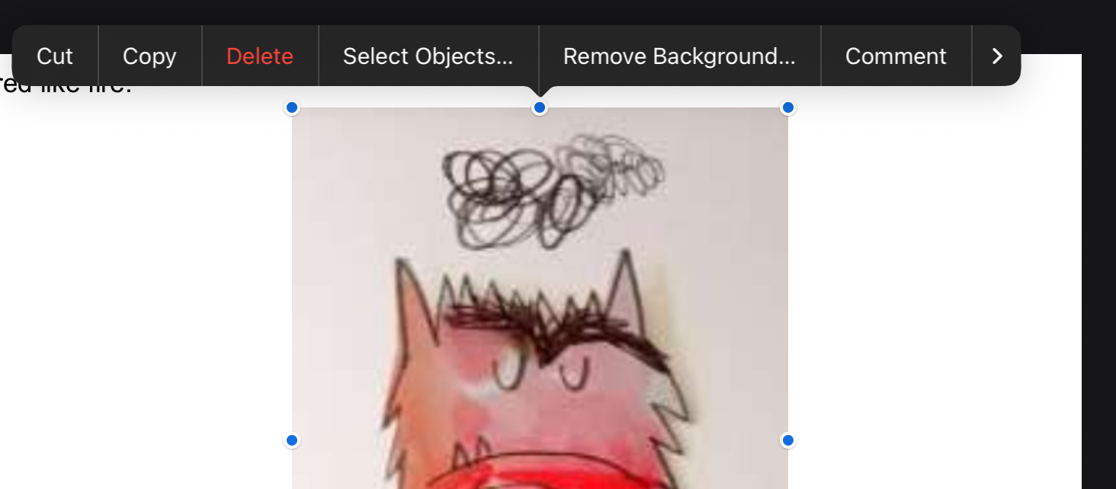
Trace 3 or 4 images
Remove the backgrounds on the rest

Slide 13
Year 3
Keynote: e-book
Lesson 3
2025 Term 1.1

Slide 14
Describe to the person next to you, how do you trace an image?
Vocab Opacity Transparent

Slide 15
Learning Objectives:
To be able to format slides on Keynote
To be able to trace an image
To be able to animate my slides to create an ebook
To be able to publish my work

Slide 16
What you should have so far:
Your own slides copy all formatted
All slides formatted clearly (same font)
At least 2 or 3 images traced

Slide 17
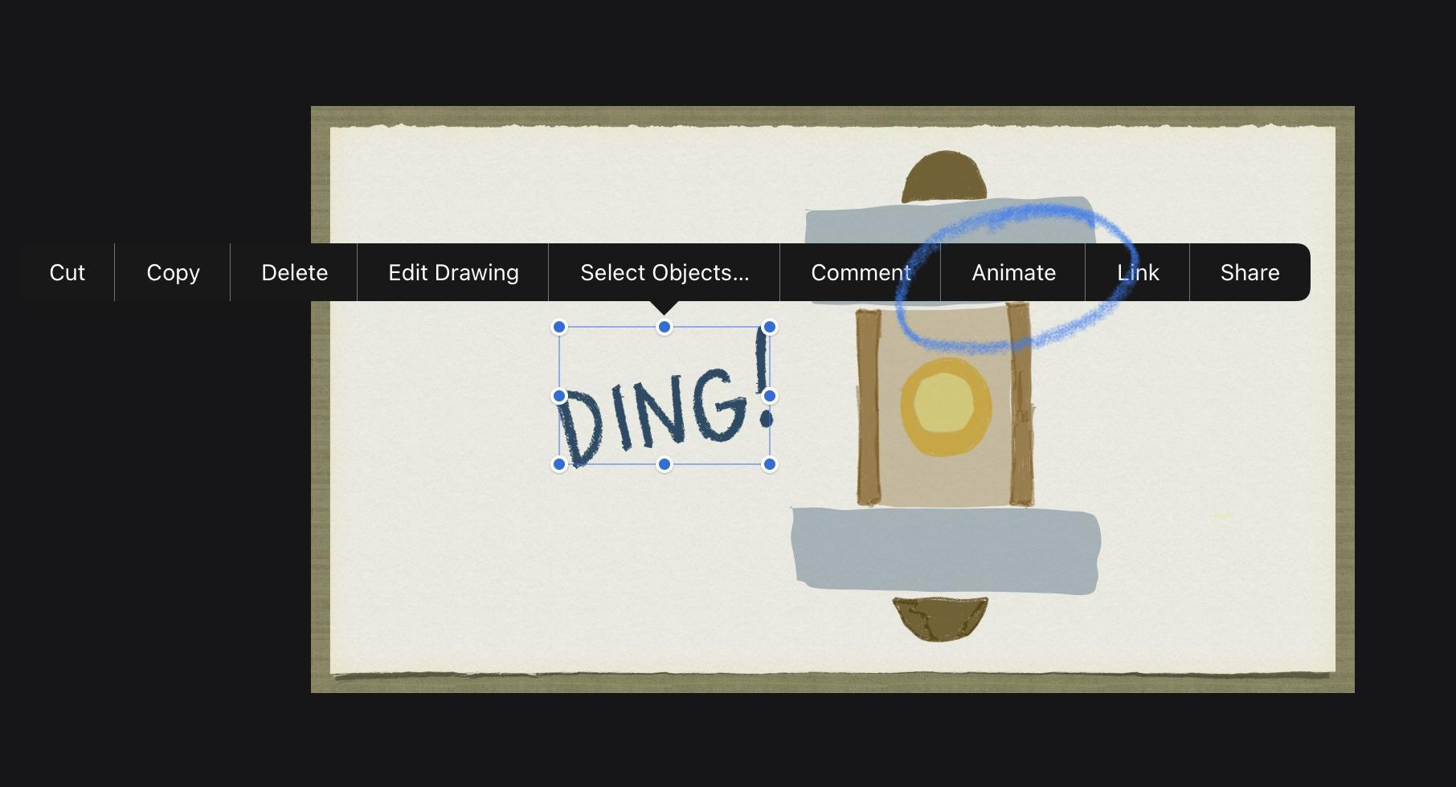
What does it mean to ‘animate’ an item?

Slide 18
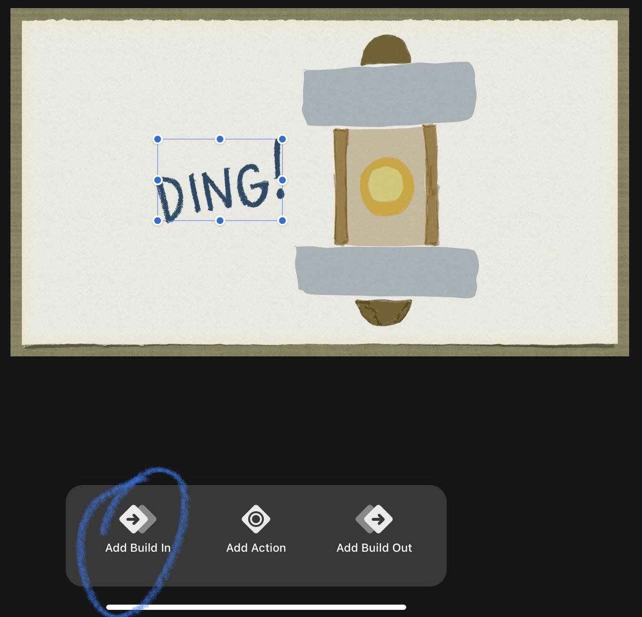
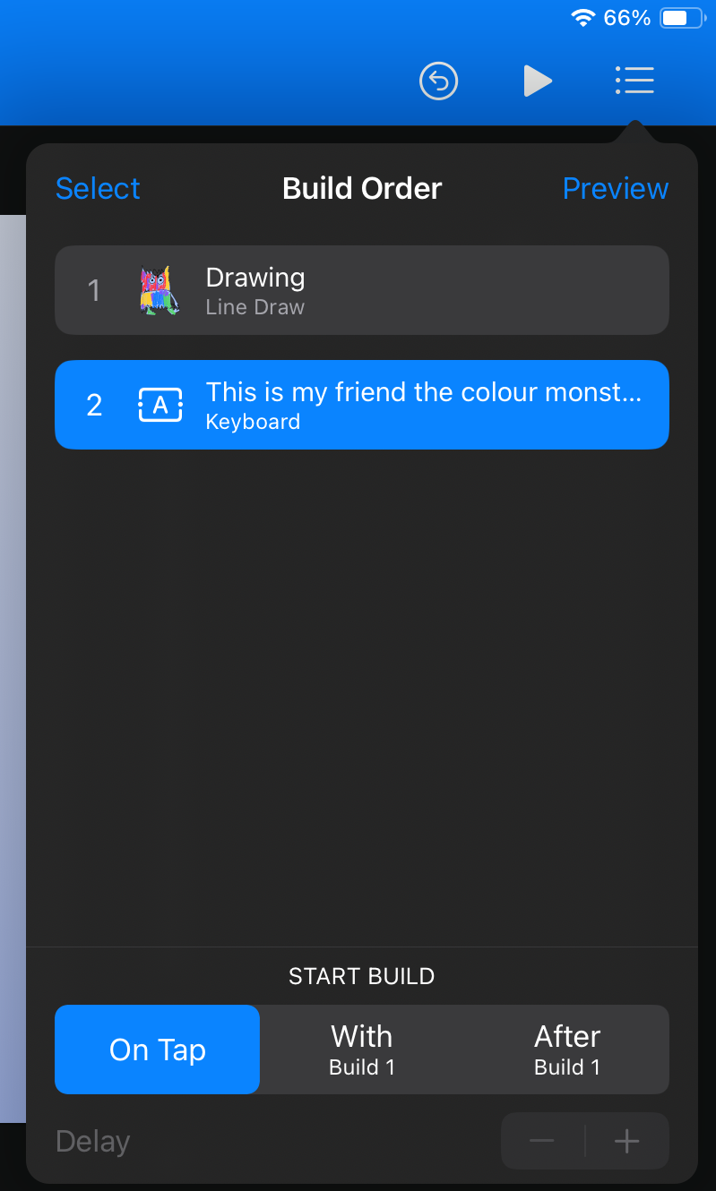
How to animate:
Remember it is an e-book it needs to be simple and clear!
Notes:
Demonstrate the good animations to include simple animations. Explain how to order the animations so text first and then images

Slide 19



Exporting to SeeSaw
Video
Notes:
Seesaw template

Slide 20
Keynote E-Book Creation
In this project our students used the keynote app to turn a story into an E-book by using a range of tools and skills such as: text & image formatting, digital drawing, animation and transitional effects.
Great effort Y3!

